Slide 1

Addressing Manufacturing Downtime challenges

Slide 2
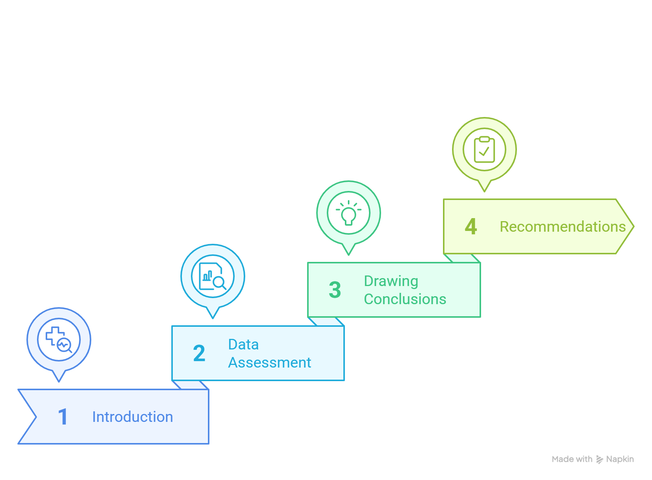
Analysis Outline

Slide 3
Introduction
In this project, we analyzed productivity and downtime data for a soda bottling production line, which includes information on the operator, product, start and end times, and the factors contributing to downtime for each batch.
We will assist them in answering questions such as:
What is the current line efficiency? (Min Time / Actual Time) * 100
Are any operators underperforming?
What are the main factors causing downtime?
Do any operators face challenges with specific types of operator error?

Slide 4
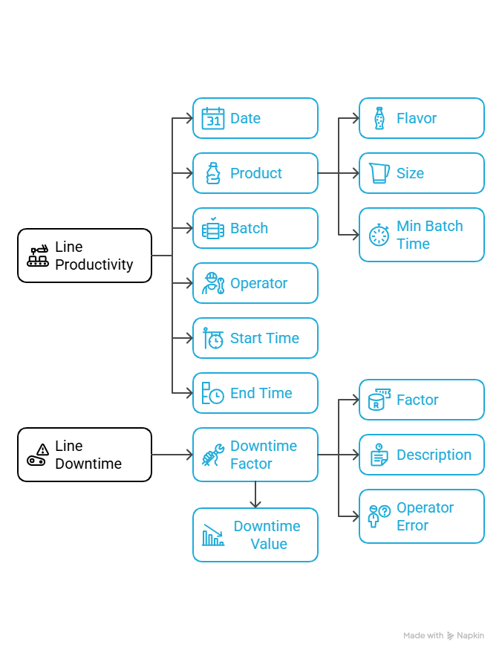
Data Description

Slide 5
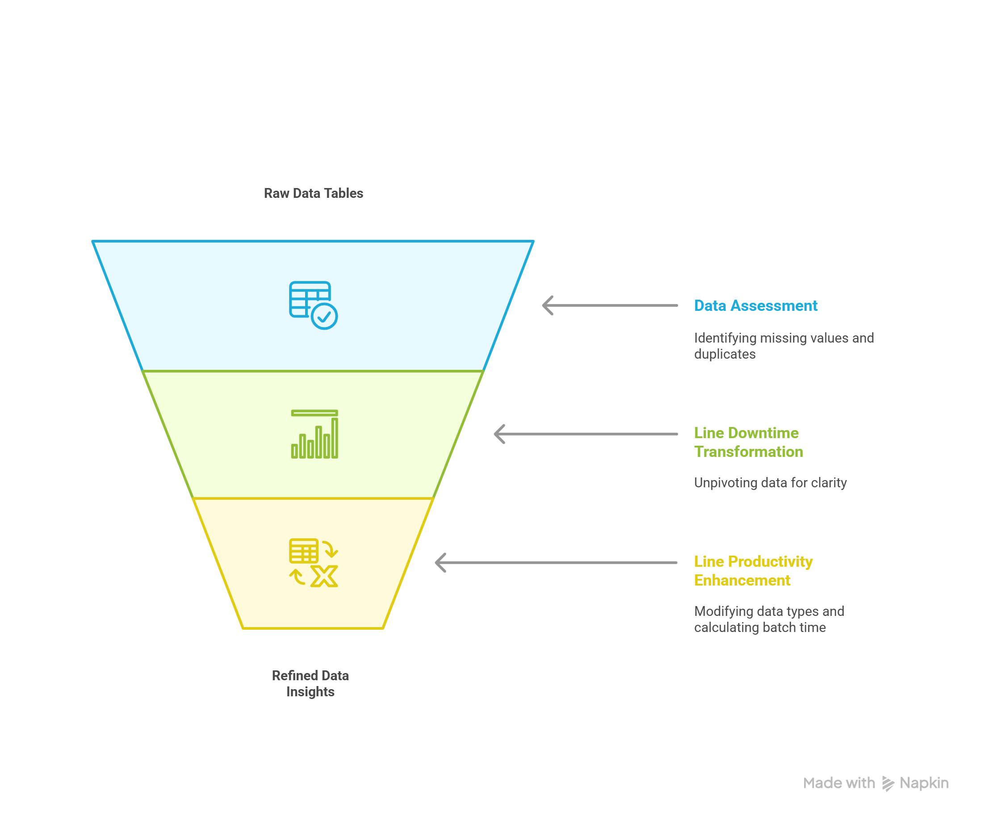
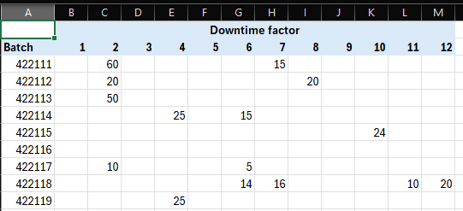
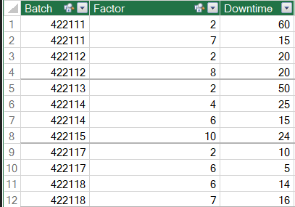

Data Assessment

Slide 6
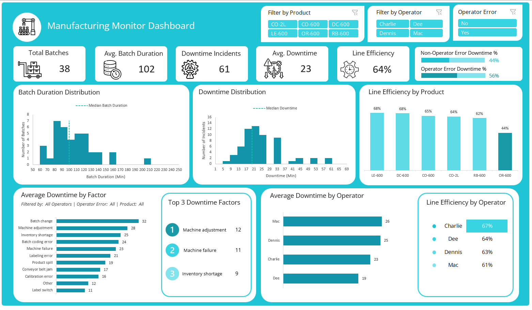
Drawing Conclusions

Slide 7
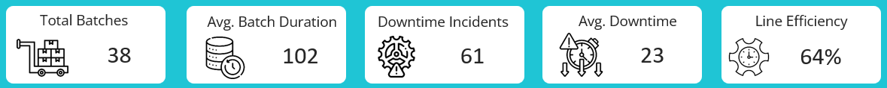
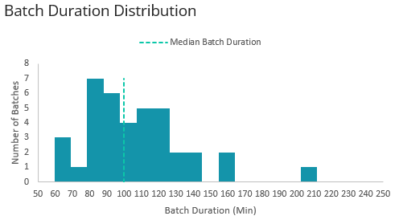
Drawing Conclusions
A total of 38 batches were produced, with an average batch duration of 102 minutes.
If we look at the distribution of actual time for batches, we find that 50% of the batches took less than 100 minutes to complete, while the other 50% took more than 100 minutes. Also, there are some outliers in the data—some batches took 160 and even 210 minutes to complete.

Slide 8
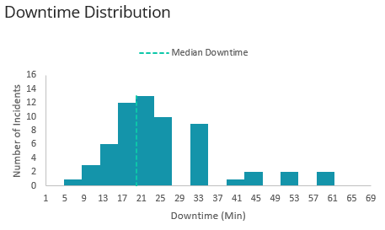
Drawing Conclusions
There were 61 downtime incidents, with an average duration of 23 minutes, meaning it took 23 minutes on average to resolve each downtime error.
Looking at the downtime distribution, we find that 50% of the incidents were resolved in under 20 minutes, while the remaining 50% took longer than 20 minutes. Additionally, some incidents took over 40 minutes to resolve, which may be considered outliers.

Slide 9

Drawing Conclusions
The overall line efficiency is 64%, meaning that only 64% of the total manufacturing time was used productively. The remaining 36% was lost due to inefficiencies such as downtime, delays, or other non-productive activities.
Further investigation revealed that 56% of the downtime resulted from operator errors, while 44% was attributed to other issues.

Slide 10
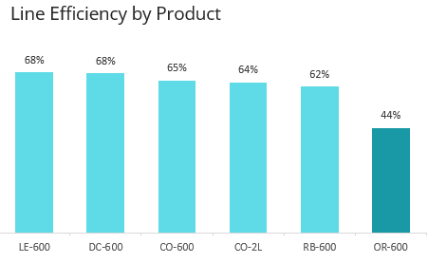
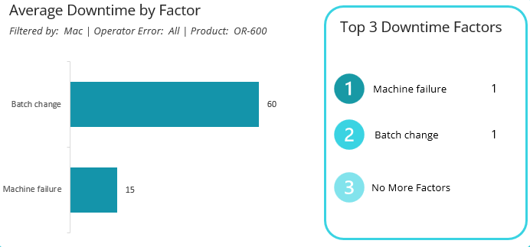
Drawing Conclusions
The line efficiency is highest for the LE-600 and DC-600 products (68%), but it is much lower for the OR-600 (44%).
Looking deeper into OR-600 to identify the factors causing downtime, we find that there was only one batch for this product. Only two downtime incidents occurred: one due to a batch change, which took 60 minutes to resolve by Mac, and another that took only 15 minutes. This is why the product has low efficiency.

Slide 11
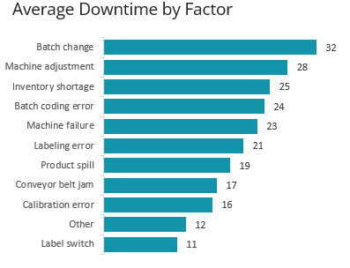
Drawing Conclusions
Among all downtime factors, Batch Change takes 32 minutes to resolve, making it the longest, and it is also classified as an operator error.

Slide 12
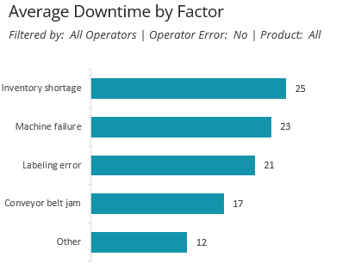
Drawing Conclusions
If we filter out Operator Error to focus on non-operator factors, we find that Inventory Shortage is the most significant issue, taking approximately 25 minutes on average to resolve.

Slide 13
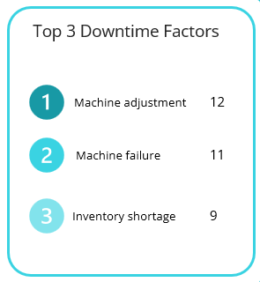
Drawing Conclusions
Most of the downtime incidents occurred due to a Machine Adjustment error, which is classified as an operator error and takes an average of 28 minutes to be resolved.
The second and third most common factors are Machine Failure and Inventory Shortage, which are non-operator errors and take an average of 25 and 23 minutes, respectively, to be resolved.

Slide 14
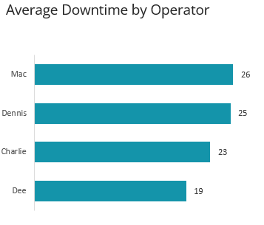
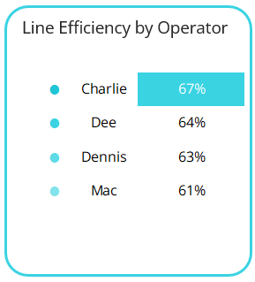
Drawing Conclusions
Looking at the performance of the operators, we find that downtime incidents occurring when Mac is in charge of the batch take an average of 26 minutes to resolve, which is the longest duration. In contrast, Dee resolves errors in the shortest time, averaging 19 minutes.
When analyzing line efficiency by operator, we found that Charlie achieved the highest line efficiency at 67%, while Mac recorded the lowest efficiency at 61%.

Slide 15
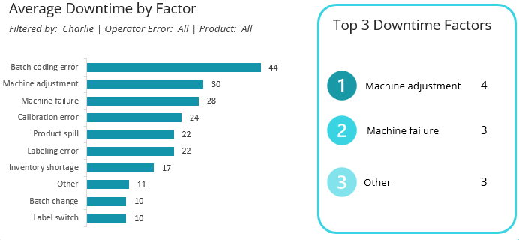
Drawing Conclusions
Downtime Factors Analysis by Operator
If we look at operator downtime factors that occurred when Charlie was in charge, we find that the Batch Coding Error is the most time-consuming issue for Charlie to resolve. Additionally, the Machine Adjustment error occurred four times.

Slide 16
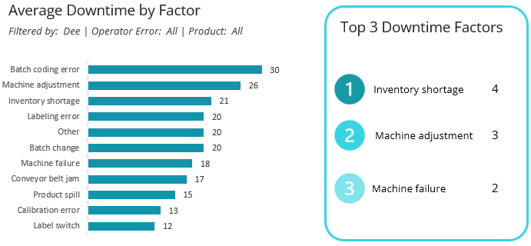
Drawing Conclusions
Downtime Factors Analysis by Operator
In addition to Charlie, the Batch Coding Error is also the most time-consuming issue for Dee to resolve, and the Machine Adjustment error occurred 3 times. Inventory Shortage was the most common error while Dee in charge.

Slide 17
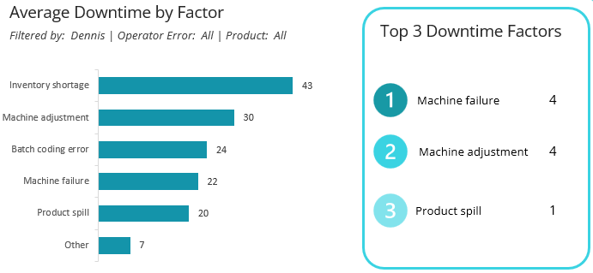
Drawing Conclusions
Downtime Factors Analysis by Operator
The Inventory Shortage error is the most time-consuming issue for Dennis, took 43 minutes on average. The most occurring errors are Machine Failure and Machine Adjustment

Slide 18
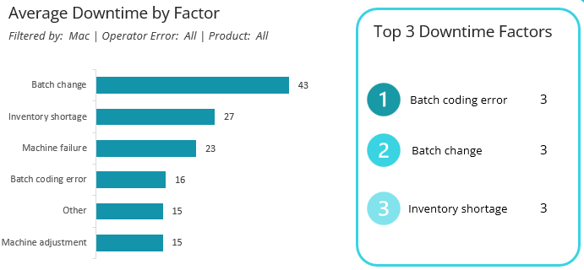
Drawing Conclusions
Downtime Factors Analysis by Operator
The Batch Change error is the most time-consuming issue for Mac, occurring 3 times. The Batch Coding Error also occurred 3 times but took an average of 16 minutes to resolve.

Slide 19
Conclusion and Recommendation
Monitoring manufacturing lines is very important. It allows you to optimize operations by identifying the factors that cause downtime. By doing so, you'll be able to resolve those issues, reduce downtime, and consequently increase production. This dashboard will help you achieve that. It provides a clear explanation to help you identify the top factors causing downtime and whether they are related to a specific operator. Let's reveal the insights we discovered so far.
Note: This data was recorded over just 5 days, between 8/29/2024 and 9/3/2024.
There are a total of 38 batches produced, with an average batch duration of 102 minutes. After we looked at the batch duration distribution, we found that 50% of the batches took less than 100 minutes to complete, while the other 50% took more than 100 minutes. In addition to that, there are some outliers in the data; some batches took 160 and even 210 minutes to complete, double the minimum time.
Moreover, there were 61 incidents, with an average duration of 23 minutes, meaning it took 23 minutes on average to resolve each downtime error. Looking at the distribution of the downtime, we find that 50% of the incidents were resolved in under 20 minutes, while the remaining 50% took longer than 20 minutes. Additionally, some incidents took over 40 minutes to resolve, which may be considered outliers.
The overall line efficiency is 64%, meaning that only 64% of the total manufacturing time was used productively. The remaining 36% was lost due to inefficiencies such as downtime, delays, or other non-productive activities. Further investigation revealed that 56% of the downtime resulted from operator errors, while 44% was attributed to other issues.
The line efficiency is highest for the LE-600 and DC-600 products (68%), but it is much lower for the OR-600 (44%).
Looking deeper into OR-600 to identify the factors causing downtime, we find that there was only one batch for this product. Only two downtime incidents occurred: one due to a batch change, which took 60 minutes to resolve by Mac, and another that took only 15 minutes. This is why the product has low efficiency.

Slide 20
Conclusion and Recommendation
Looking at the average downtime by factor, we found that among all downtime factors, Batch Change takes 32 minutes to resolve, making it the longest, and it is also classified as an operator error. In the other hand, if we look at the non-operator error, we will find that Inventory Shortage is the most significant issue, taking approximately 25 minutes on average to resolve.
Most of the downtime incidents occurred due to a Machine Adjustment error, which is classified as an operator error and takes an average of 28 minutes to be resolved. Moreover, the second and third most common factors are Machine Failure and Inventory Shortage, which are non-operator errors and take an average of 25 and 23 minutes, respectively, to be resolved.
Looking at the performance of the operators, we find that downtime incidents occurring when Mac is in charge of the batch take an average of 26 minutes to resolve, which is the longest duration. In contrast, Dee resolves errors in the shortest time, averaging 19 minutes. When analyzing line efficiency by operator, we found that Charlie achieved the highest line efficiency at 67%, while Mac recorded the lowest efficiency at 61%.
Downtime factors analysis by operator
If we look at operator downtime factors that occurred when Charlie was in charge, we find that the Batch Coding Error is the most time-consuming issue for Charlie to resolve. Additionally, the Machine Adjustment error occurred four times.
In addition to Charlie, the Batch Coding Error is also the most time-consuming issue for Dee to resolve, and the Machine Adjustment error occurred 3 times.
The Machine Adjustment error is the most time-consuming issue for Dennis, occurring 4 times.
The Batch Change error is the most time-consuming issue for Mac, occurring 3 times. The Batch Coding Error also occurred 3 times but took an average of 16 minutes to resolve.
Recommendations:
The overall line efficiency is only 64%, which is low, and we need to work on improving it. This may be because the data was recorded over just 5 days, and the manufacturer is new and still figuring out how everything works.
Each operator struggled with a specific type of error that took time to resolve. We need to support them and provide training to help reduce that time. For example, Mac took an average of 43 minutes to resolve a Batch Change error, while Charlie took 44 minutes on average to resolve a Batch Coding error.

